Slide 1
Understanding Your Personal Context
EN 102

Slide 2

Understanding your Personal Context
How we view the world is deeply entwined with our attitudes and beliefs.

Slide 3
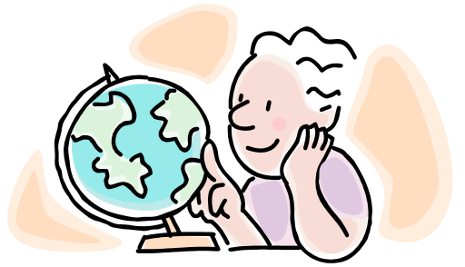
Understanding your Personal Context
Our underlying beliefs, sometimes unchallenged and unacknowledged, affect what we believe to be true and how we respond to information.

Slide 4

Understanding your personal context
Without understanding and examining these foundational values and beliefs, it is difficult to develop effective arguments because we will not be in the habit of challenging our own beliefs.

Slide 5

Understanding your Personal Context
It also puts us at a disadvantage in understanding the attitudes and beliefs of our audience.

Slide 6
Understanding your Personal Context
Let’s spend some time exploring and understanding what influences our fundamental values and beliefs in the following exercise.

Slide 7
Understanding your Personal Context
Each of the following eight areas is a dimension of our lives which has influence over our attitudes, values and beliefs.
For each area, jot down a paragraph that describes your identity as it relates to that area.

Slide 8
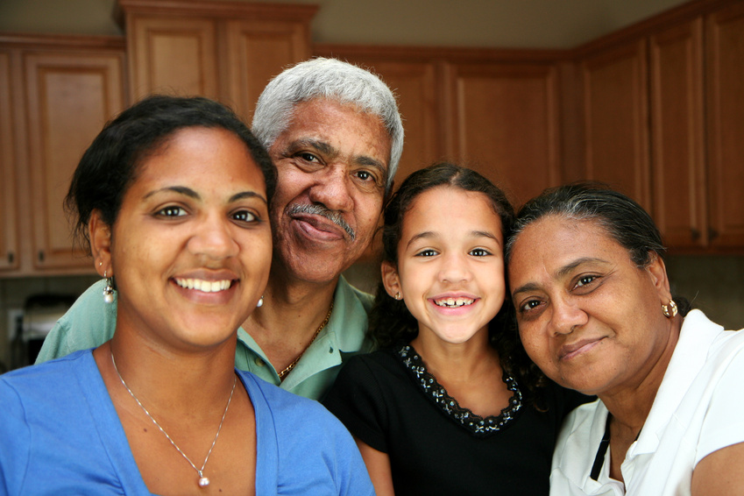
Understanding your Personal Context
Dimension 1: Family
Where you were born? Who is part of your family? What is your role in your family?

Slide 9
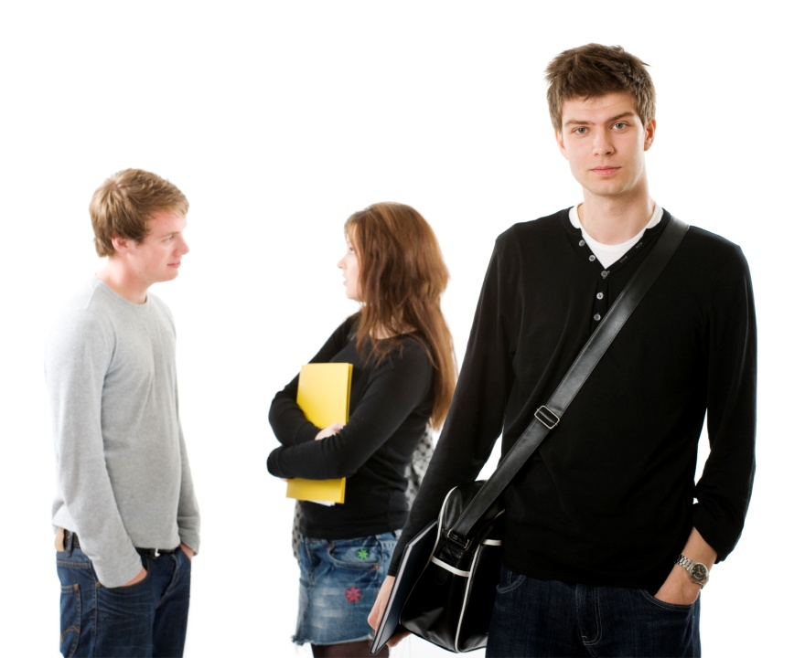
Understanding your Personal Context
Dimension 2: Social
What is your role in society and your peer group? How do you view yourself in regards to others?

Slide 10
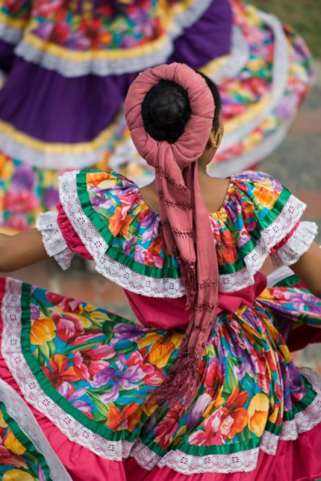
Understanding your Personal Context
Dimension 3: Culture
How do you identify yourself in regard to race and/or ethnicity?

Slide 11
Understanding your Personal Context
Dimension 4: Professional/Career
What is your educational and working background?
What are your goals and aspirations?
Who are your role models?

Slide 12
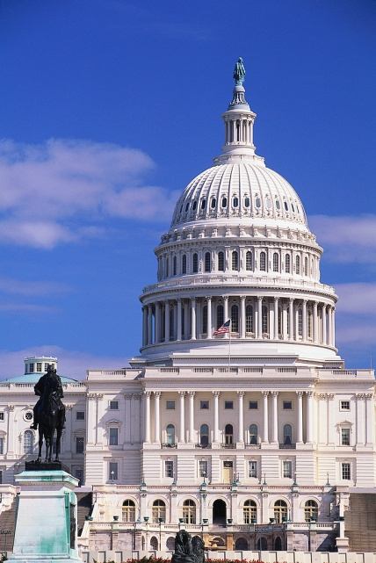
Understanding your Personal Context
Dimension 5: Political
What are your political leanings, and what influences them from other dimensions? Where do you get information about the world and current events?

Slide 13

Understanding your Personal Context
Dimension 6: Spiritual
What are your thoughts on religion or other forms of spirituality?

Slide 14
Understanding your Personal Context
Dimension 7: Personal
Are there other areas that play a significant role in who you are and what you believe? Some things you might include here are: hobbies and interests, relationships, appearance, style, personality type, etc.

Slide 15
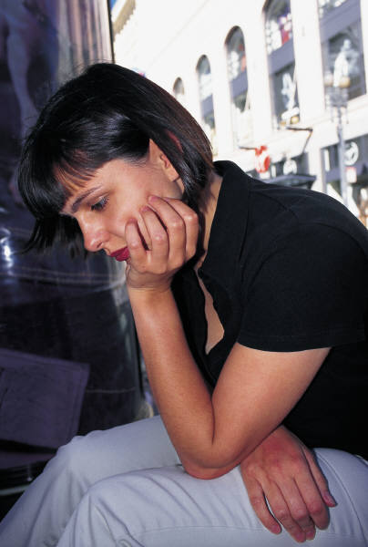
Understanding your Personal Context
Dimension 8: Experience
Are there any significant experiences or turning points in your life which have impacted who you are today?

Slide 16

Understanding your Personal Context
Consider the following characters and their personal contexts. Think about how each of these people would react to the issue of whether or not a college education is worth the money.

Slide 17
Understanding your Personal Context
Marla
Marla is a 74 year-old woman, long divorced, who has been politically active in feminist and peace movements. A motivated self-learner, Marla did not attend college because she married young and was busy raising her children. She is an atheist, a breast cancer survivor, and an avid reader who does not own a television. She has three children and five grandchildren. Until her retirement, she worked as a secretary for a nonprofit organization that provides legal assistance to low-income renters.

Slide 18
Understanding your Personal Context
Juan
Juan is a 51 year-old, married father of two teenage sons. He owns a small but successful chain of local restaurants. He drives a Hummer and owns a large house in an upscale suburb, and he runs and works out at a gym several times a week. He is a veteran of Desert Storm, the 1991 U.S. invasion of Iraq. He used the GI bill to complete his AA degree in business. He is also an avid hiker and skier who loves the outdoors. In the last election, he voted Republican.

Slide 19
Understanding your Personal Context
Anna
Anna is a 19 year-old student at Montgomery College. She is a devout Christian and was homeschooled until she began college at MC. Prior to moving to Montgomery County, she lived in a rural area of Virginia where most people own guns to protect against wildlife, and she never visited a large city until she was fifteen. Her older brother graduated from the University of Maryland with a degree in Environmental Science and now works for the National Park Service. For the past three years, she has volunteered at a recreation center for at-risk inner-city youths.

Slide 20
Understanding your Personal Context
Bear
Bear is a 34 year-old single woman who was raised on a communal organic farm but who followed her love of technology into the computer industry after earning a B.S. in computer science. Because she entered the field before the dot-com boom, her stock options made her extremely wealthy, and she has invested wisely. She started as a video game programmer and rapidly went through a series of promotions until she began her current position as a lobbyist for her corporation. Lately, however, Bear has begun to question the materialism of her life and is considering leaving her job to become a high school math teacher near where she grew up.

Slide 21
Understanding your Personal Context
Lou
Lou is 24 years old, single, and a Peace Corps volunteer. After high school, he tried one semester of college, but, although he got fairly good grades, he decided it wasn’t for him. He means to go back eventually, but so far he hasn’t. His current philosophy of life is to have as much fun as possible and worry about the future as little as possible. He pays little attention to politics and has never voted, even though he is eligible. Through the Peace Corps, he has worked in several developing countries. He maintains long-distance friendships and family relationships through Facebook and Skype, and he enjoys playing video games.

Slide 22
Understanding your Personal Context
You will revisit these characters for future assignments in Unit 1.

Slide 23
Understanding your Personal Context
THE END

